Slide 1

Advantage Azure (Level 100)
27th December, 2018

Slide 2
Contents
1
OUR OFFERINGS
2
OUR SOLUTIONS AND ACCELERATIONS
3
DIFFERENTIATORS
4
CASE STUDIES
5
APPENDIX

Slide 3

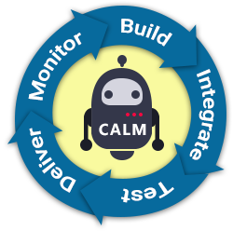
Our Offering
App Dev
CALM
Architecture
Testing
DevOps

Slide 4

AA Architecture
Assessment of Cloud Readiness
Enterprise Cloud Strategy & Roadmap Planning
Tools Selection for RAD
Workshop on
Cloud Concepts
Business Benefits & Requirements on new Apps
Assessments on
Feasibility, Architecture
Service Evaluation
Cost, Time and Risks
Planning on
Business Benefit
Transition Planning
Business Case
Workshop to
Establish Scope & Approach
Set Strategic Vision
Identify & Prioritize Capabilities
Work to
Profile Capabilities
Recommend Deployment Pattern
Recommend Migration Approaches
Define
Opportunity & Priority
Business Transformation Roadmap
Analyse
Business and Technology needs
Migration needs
Cost-Benefit
Licensing, Upgrade & Support
Evaluation
Proof of Concept
Pilot
Due Diligence
Notes:
Change

Slide 5
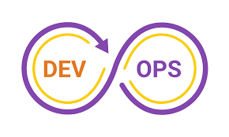



AA Application Development
Micro Services & API Dev on Azure
PaaS App Dev on Azure
Server less App Dev on Azure
Microservices using Azure Container Service and using Azure Service Fabric
Azure Load Balancer
Azure Public nodes
Azure Backend nodes
Azure API Gateway
Azure Service Fabric Cluster
Azure Management VMs
PaaS App Dev on following areas
Azure App Services
Azure Cognitive Services
Azure Bot Services
Azure Machine Learning
Azure IoT
Development of
Azure Function
Azure Batch
ADvantage Code - ADC
End-to-end agility in application life cycle: dev, test, and deployment
Automation for cost effective build and release
Azure DevOps
ALMSmart, AD-ALM
Key Customers

Slide 6


AA Application Development - App Modernization
Modernization of Monolithic Application
Migrate to Azure
Data Migration
Analysis of Monolithic applications
Code redevelopment (Focus on Reusability)
Adopt Evolutionary Design
Implementation using Azure Service Fabric
Rehost
Revise
Replatform
Refactor
Rebuild
Migrate to SQL Azure using tools
Installation, configuration of SQL Server within Azure VM and migrate data there.
Installation, configuration of Respective DB Server within Azure VM and migrate data there.
No-SQL, Mongo DB etc.
ADvantage Migrate - ATMA
End-to-end agility in application life cycle: dev, test, and deployment
Automation for cost effective build and release
Azure DevOps
ALMSmart, AD-ALM
Key Customers
Notes:
Change

Slide 7
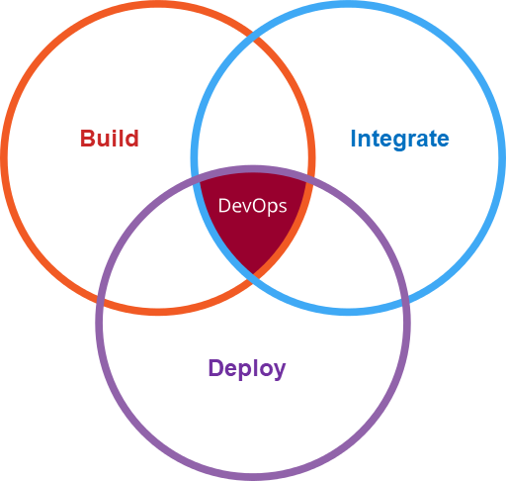
AA Testing
UNIT
The smallest piece of testable software is tested in the application to determine whether it behaves as expected or not.
<< Testing Types >>
CONTRACT
Test the agreed contract for APIs and other resources that are provided by the Microservice
INTEGRATION
Integration tests are used to test the communication between services.
END-TO-END
End-to-End Testing, Tests a complete flow through the application or Microservice.
FUNCTIONAL
User interface testing, or functional testing, is the highest level of testing and includes front-end integration and tests the system as an end-user would use it.
PERFORMANCE/LOAD
Performance testing of Microservices is to observe how well the application performs when a high number of calls are made to Microservices or a large amount of data is transferred between individual services on the network.
SECURITY
Security testing is the practice of testing a computer system, network or web application to find security vulnerabilities that an attacker could exploit.
UNIT
CONTRACT
INTEGRATION
END-TO-END
PERFORMANCE
FUNCTIONAL
SECURITY

Slide 8
AA DevOps
Continuous Feedback
Continuous Feedback
Continuous Feedback
Continuous Feedback
Continuous Integration
Continuous Deployment
Continuous Testing
Continuous Monitoring
Activities
Centralized Version Control
Code Reviews and SCA
CI Pipeline Creation
Migration scripts execution
MSA and service fabrics
Manual Test planning
Automated unit testing
Telemetry Development
Adopt TTD practices
Activities
Deployment scripts
On-demand Release Mgmt.
Deploy to Dockers
AKS Deployments
Establish DevOps Dashboards
Activities
Test case creation – manual / automated
Manual Test Execution
Extend pipeline to support 3rd party testing tools
Automated Testing
Performance Testing
Web and service testing
Telemetry Report generation
Transform from manual to Automated testing
Activities
Define DevOps goals, metrics, SLA
Metrics based Continuous Monitoring
Focus on Continuous Improvement
Monitor Dockers / Containers
Monitor Apps performance
Log management
Deployment Error tracking
Monitor DevOps Dashboards
Notes:
Change

Slide 9

AA CALM
Discovery
Planning & Designing
How many App owners are still missing?
DevOps
Project Management
Execution
What are the issues with my “A” App?
How many Apps could be modernized?
Testing
How can I help you?
Please recommend the correct “R” for “A” App!
Could you upgrade App “A”?
Manage
Could you create a Microservice?
Could you execute test case “T” on App “A”?
Support
How many SEV1 test failures are there?
Could you create Build & Release Pipelines?
Could you generate schedule slippage metric?
Could you show SEV1 tickets for last 1 Year
Could you close ticket “T” as problem is solved?

Slide 10
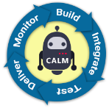
Differentiators
ADvantage-Code Framework
ADvantage Migrate - ATMA
Framework to generate API & Microservices code based on project need. It addresses following challenges.
Application Compatibility
Cope with new technology trends
Kalibre Framework
Academy Tool
Code conversion tool
Tool for onboarding and training
Framework for assessment
1
3
5
7
2
4
6
CALM -Conversational Platform for
App LCM
ALMSmart Framework
Application 360 / ADALM Framework
ALM platform for managing projects and programs
unified view of project to various stakeholders
At the heart of our
Modern App/AD Solution.
Please click the link to watch a short demo of Advantage-Code.

Slide 11



Case Studies
Our Customers
Objectives
Key Challenges
Our Solution & Roadmap
Our Services
Azure Components
The Solutions:
Platform built with common UI components & templates. Iterative development & loose coupling between UI & Backend APIs, resulting in fast mockups of UI & parallel development on APIs. HCL IPs like ADC, ALMSMART and ADALM frameworks were used.
Benefits:
End to end DevOps is in place
Modernize the web platform to be accessed through Multiple customer channels and devices
It should be available to partner channels with proper controls and security in place
Azure Service Fabric
Azure Batch
Azure App Services
Azure Functions
Azure PaaS App Development
Azure Server less App Development
Enterprise level platform to run business with improved time-to-market, Quality, customer satisfaction, and reduced cost
The Solutions:
Proactive recommendation to improve existing delivery processes and implement a continuous delivery platform. Tool & technology recommendation, evaluation, selection and implementation. Same HCL IPs (as above) were used.
Benefits:
75% reduction in environment creation
80% reduction in new application node creation
70% reduction in deployment time
Fragmented IT operations at enterprise level
Different release mechanism for different environments
Micro services & API Dev on Azure
Azure PaaS App Development
Azure Server-less app development
Azure Batch
Azure App Services
Azure Functions
To move away from multiple online platforms to a single customer portal for all services, to enhance the customer experience
The Solutions:
Digital Business Platform to serve as common online platform & Data Event Management. Brought multiple data sources into Hadoop & used API based service calls for track and trace. Release frequency has been improved 10-12 times a month as compared to 1-2 per month. This was a 90% improvement through the use of ADC.
Benefits:
90% reduction in environment creation using ALMSMART
90% improvement in environment configuration incidents
Fragmented IT Landscape
Disparate applications, working in silos
No single view of customer
Azure PaaS App Development
Azure App Services

Slide 12



Practice Snapshot
Azure Data & AI
Offerings
Enterprise Productivity Services
STRONG DELIVERY
EXCELLENCE ON MICROSOFT
Gold Certified Partner
DELIVERING INNOVATIVE SOLUTION USING BEST BREED TECHNOLOGY AND EMPLOYEE EXPERIENCES WITH QUALITY AND AGILITY
150+ customers
2500+ consultants
Analytics Pathways
Data for Digital Transformation
Data Lake Services
EDW Development & Sustenance
Big Data on Azure
Cognitive Services
Platform Modernization
Workforce Transformation
Wisdom Modernization
Innovative Learning & Training
Multivariate Networking
Collaboration
Search
Portals
Application Modernization
Application
Offerings
Analytics 550+
Microsoft Relationship
DNA Pathways
SAP on Azure
Cloud Migration Framework
Migration and Consolidation
App Modernization
Cloud Service Management
Service Orchestration
DevOps
Architecture Modernization
App Migration
Architecture Consulting
Mobile Apps using Xamarin
APP center Integration with CAMP
Enterprise Productivity 850+
Gold Certified Partner
TAP Partner for SQL Server
MS Premium Support
Dedicated PSA
50+ Joint Engagements / Wins
Trainings and Partner Sessions
App Modernization
400+
Cloud Services
400+
Modern AD
200+

Slide 13



MS Relationship
PREFERRED STACK
GTM PARTNERSHIP
HCL is a key EA customer of Microsoft
HCL Internal Productivity Platform, Workplace Collaboration / Communication and Wiki Portal run on Microsoft technology
Workplace of the Future , NGDC, - End to End Services includes implementations, Rollouts, upgrades, and migrations covering Win 8/Office 2013, Share Point, Dynamics CRM & AX, Azure, Office 365, Advanced Analytics, Azure, etc.
Vertical solutions.
$1.5 Bn
IT/ENGINEERING
ECOSYSTEM
R&D Partnership across products in the MS Stack
Services to MSIT across Infrastructure, CRM and other key applications
30+
PREFERRED STATUS
YEARS
Amongst the select Global alliances managed by global teams.
Global System Integrators for MS Dynamics
Part of SharePoint Partner Advisory council
IPS/FRAMEWORKS
360º
Customer Experience Management Solutions.
NGDC leveraging MS stack
Workplace of the Future
Predictive iTSM, Service 360 Chain Analytics on Azure Data & AI
Azure based solutions – SAP on Azure, Azure IaaS, Azure PaaS (Socialytics and Risk operational Analytics).
PARTNERSHIP
OEM PARTNERSHIP
HCL Group is one of the largest OEM Partner of Microsoft
GOLD CERTIFIED PARTNER

Slide 14
Thank You!!!
Write to us at Enterprise Productivity Services

